Slide 1
AIRFRAME TEAM
WEEK 8 PROGRESS REPORT
30-06-2023

Slide 2
OVERVIEW
Installation of the deflector plate
Assembly of Fiberglass/Aluminum Frames
Fin Design

Slide 3
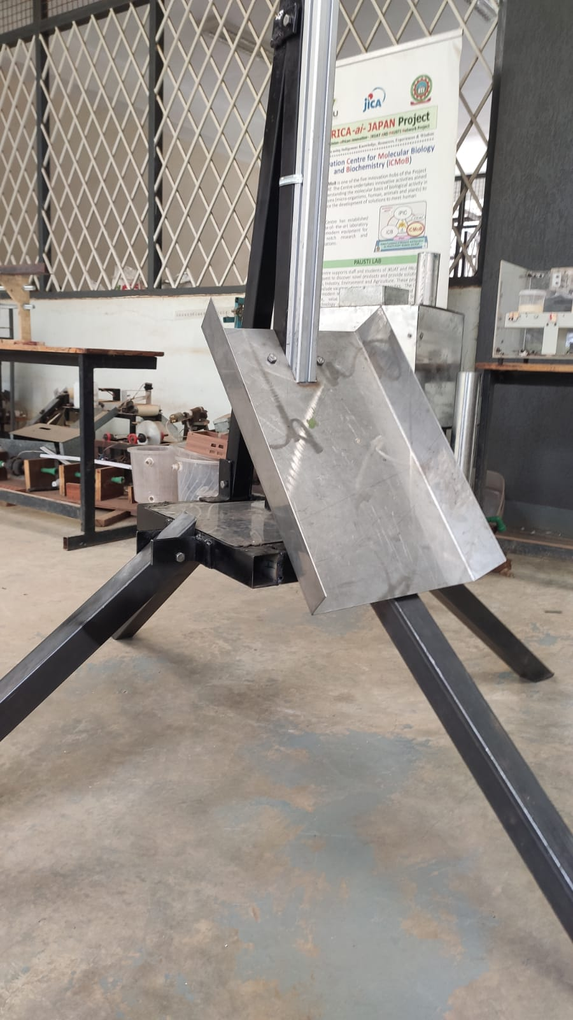
Installation of the deflector plate
Features:
3 mm thick Steel plate
Will include clay
50 cm (L) * 30 cm(W) *7cm (H)
Inclined at 45 Degrees

Slide 4
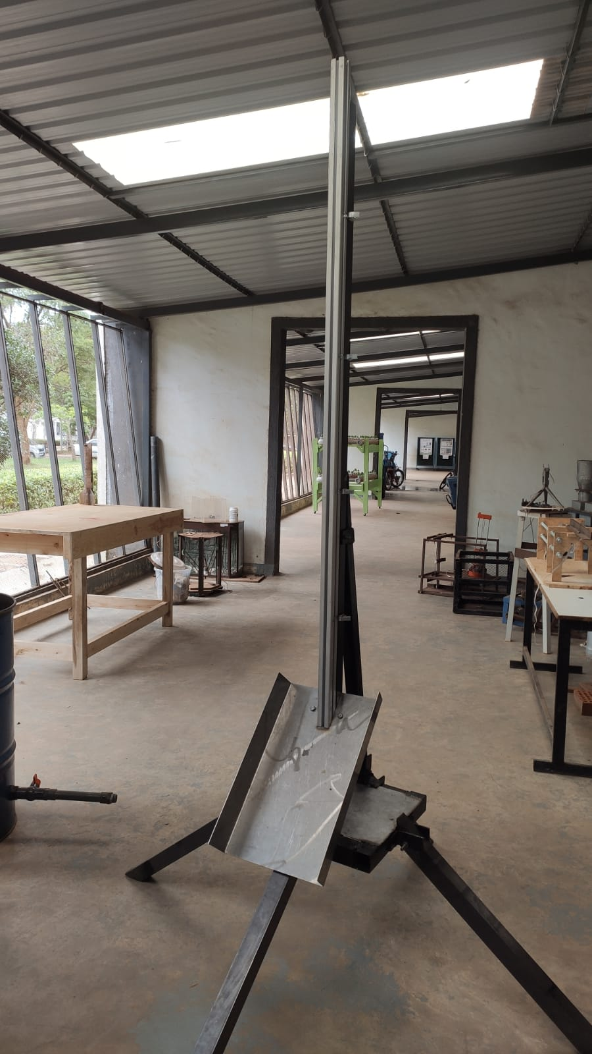
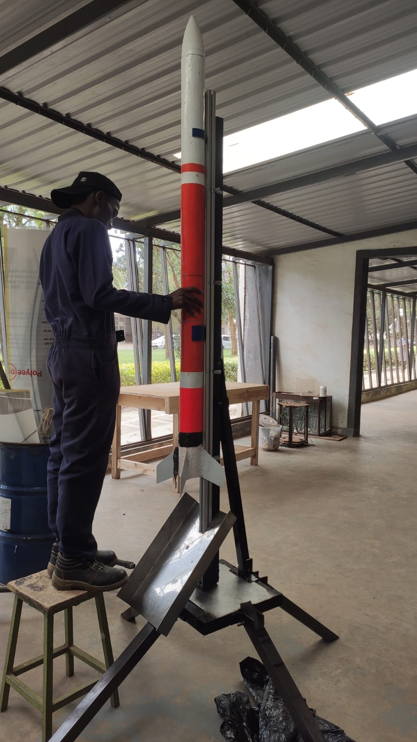
Deflector Plate
Snap pic with rocket in place

Slide 5
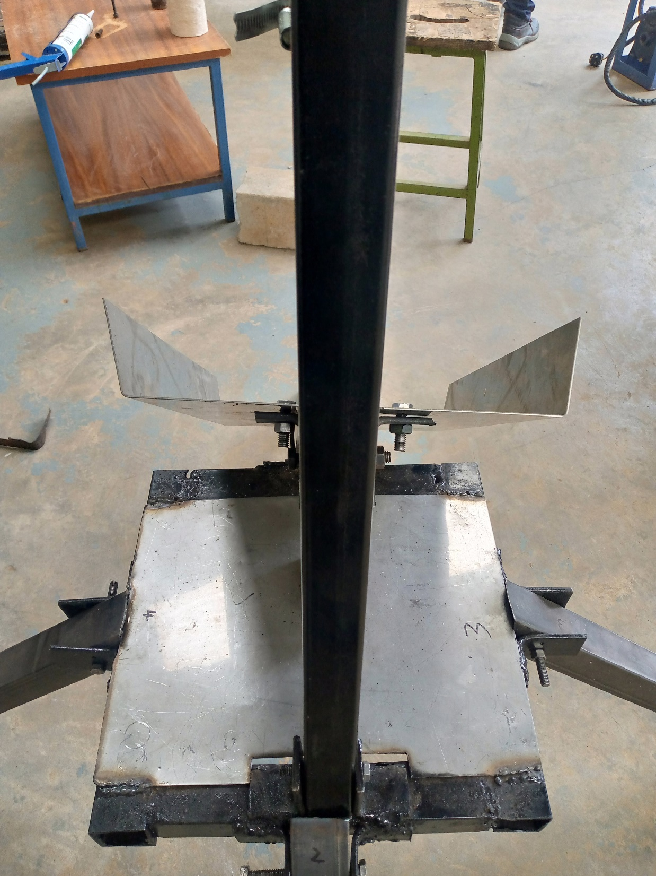
Two bolted nuts on each side
One holding the deflector plate
One attached to the launch pad mast

Slide 6
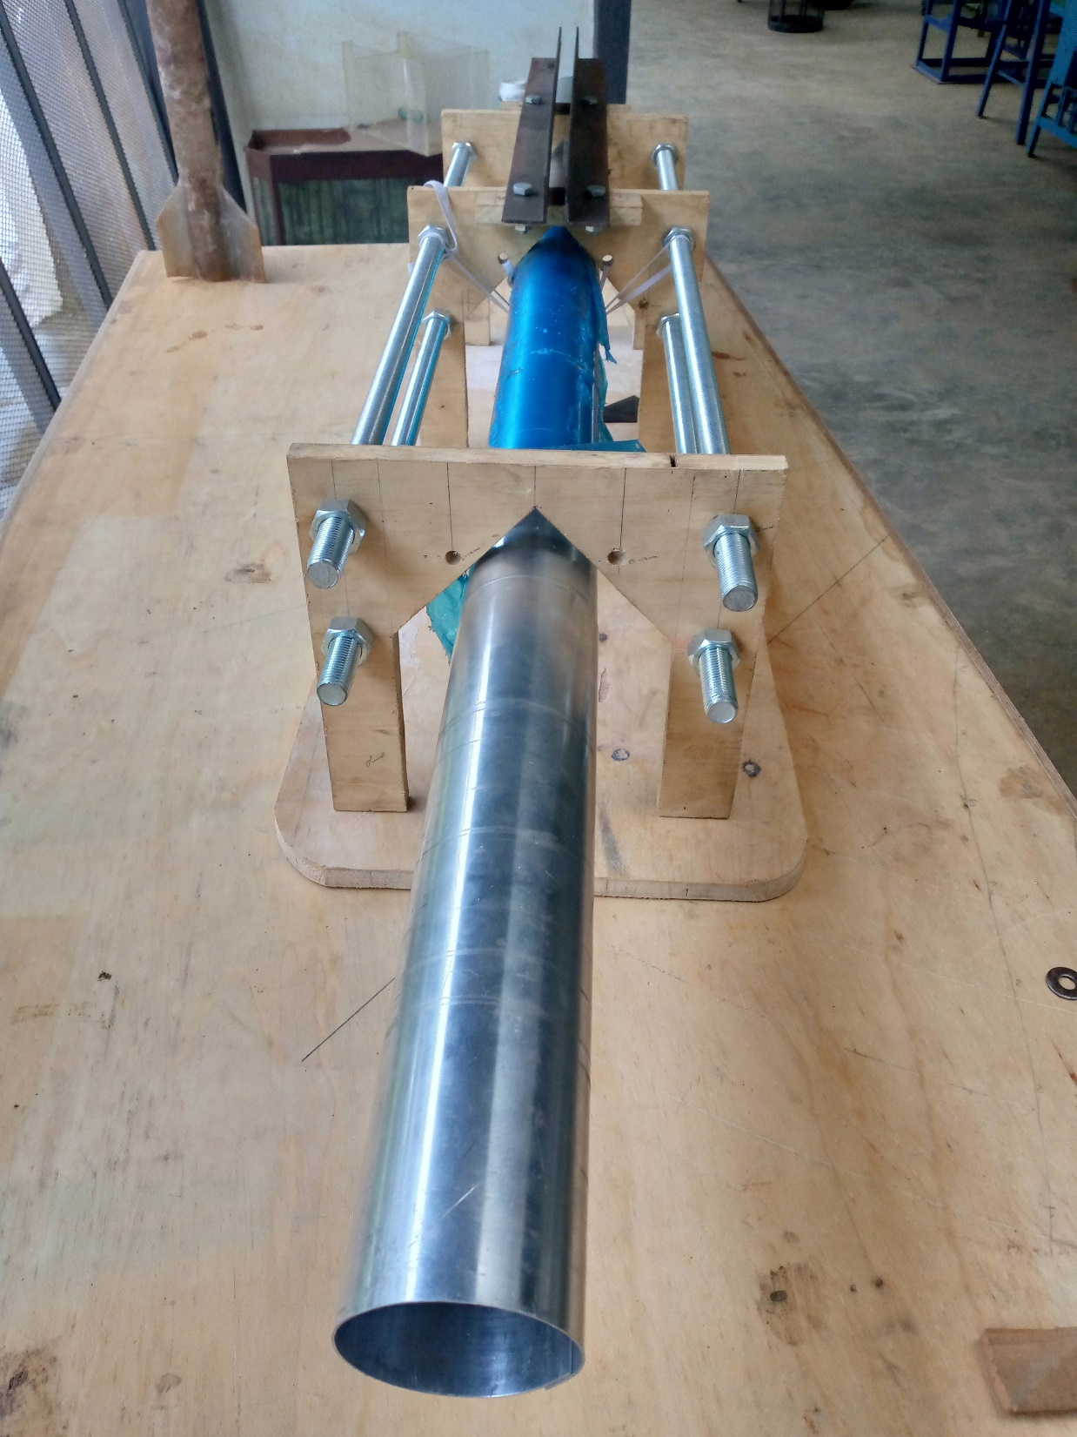
ASSEMBLY OF AIRFRAME TUBES
The 80 mm aluminum tube;

Slide 7
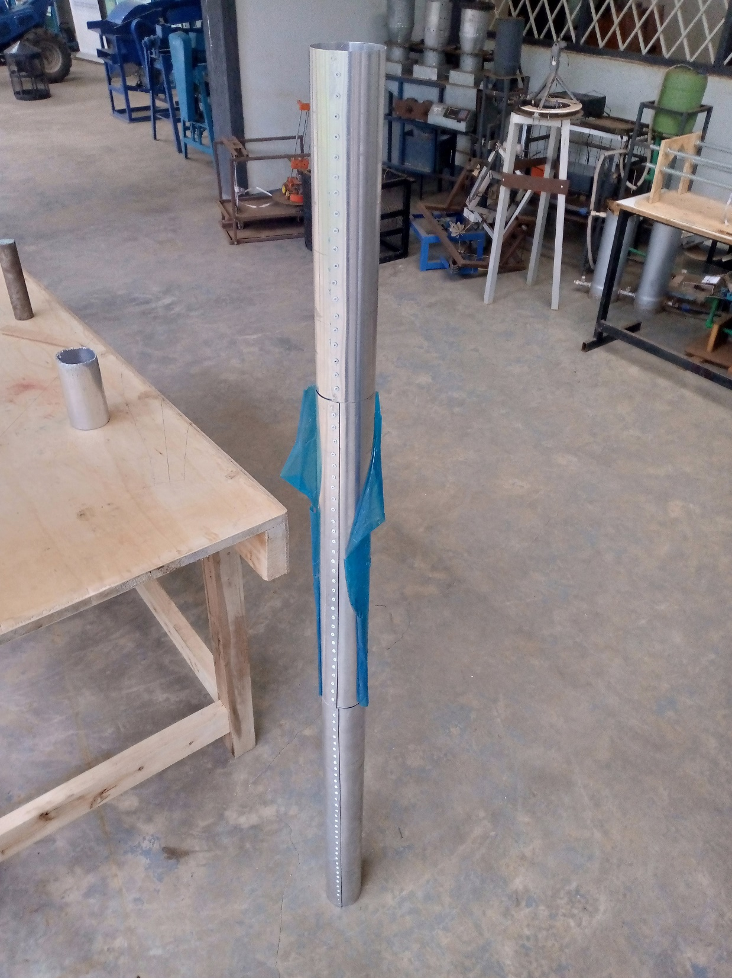
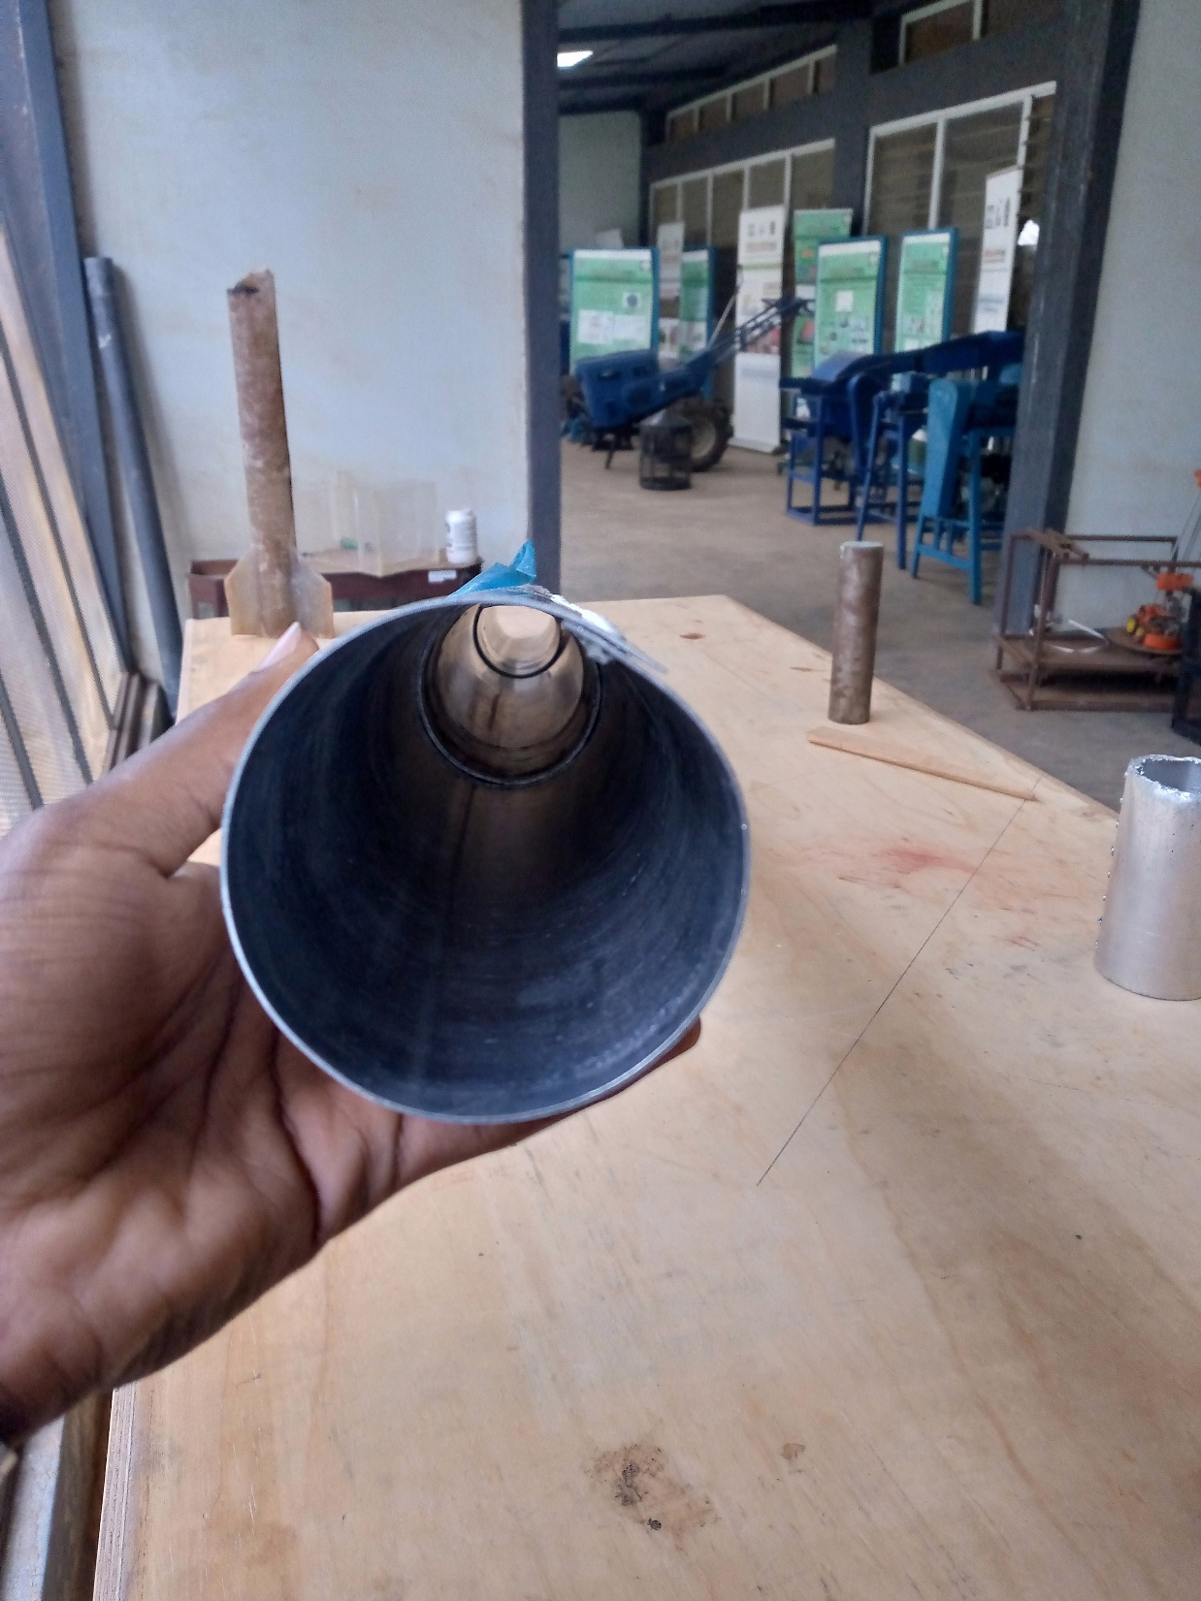

Slide 8
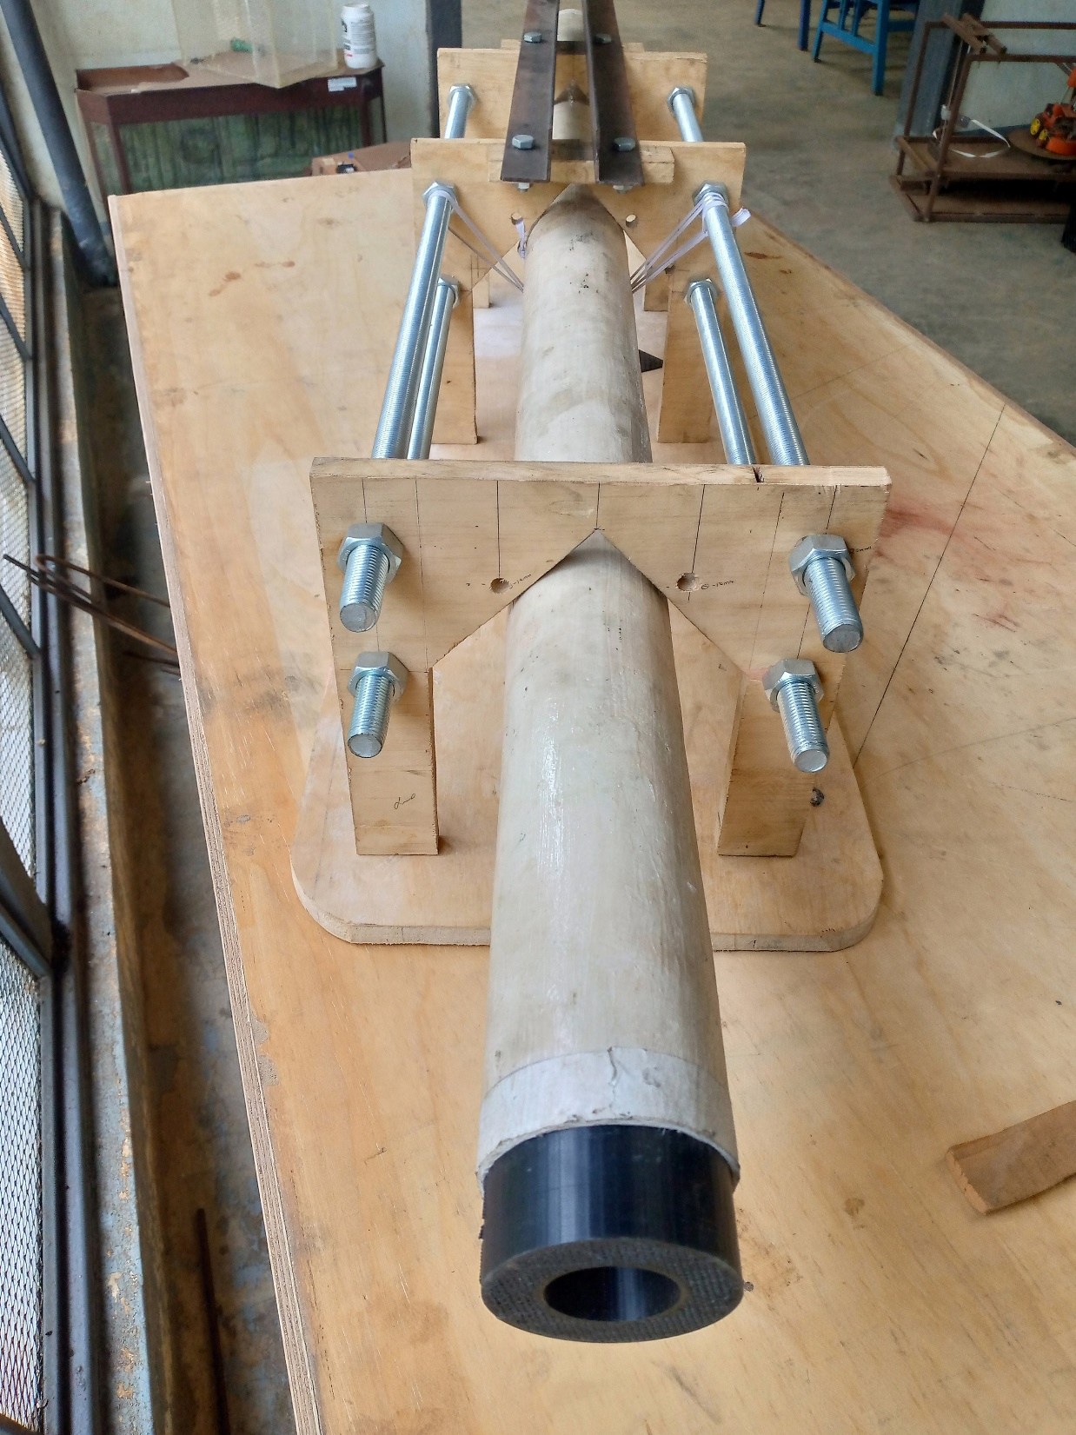
ASSEMBLY OF AIRFRAME TUBES
Fiber glass tube;

Slide 9
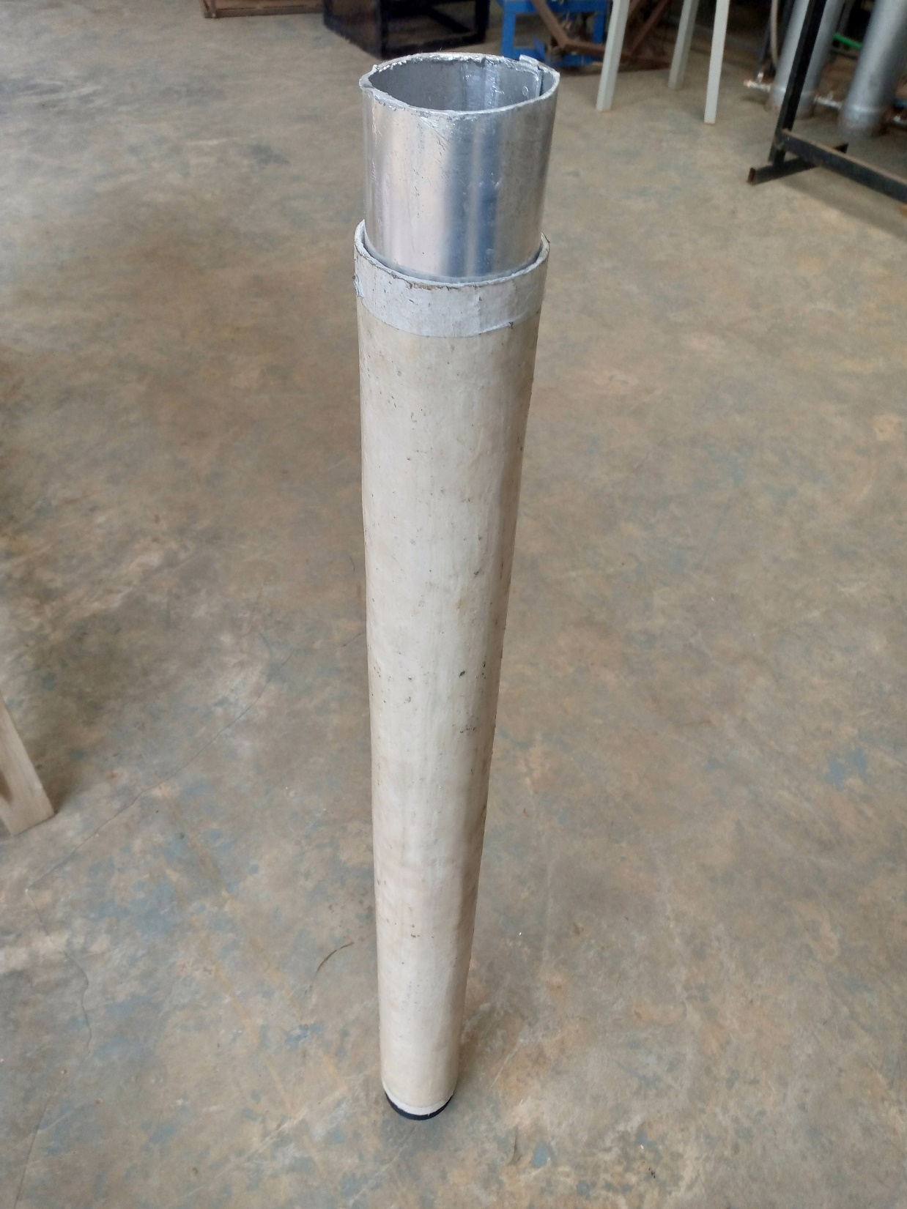
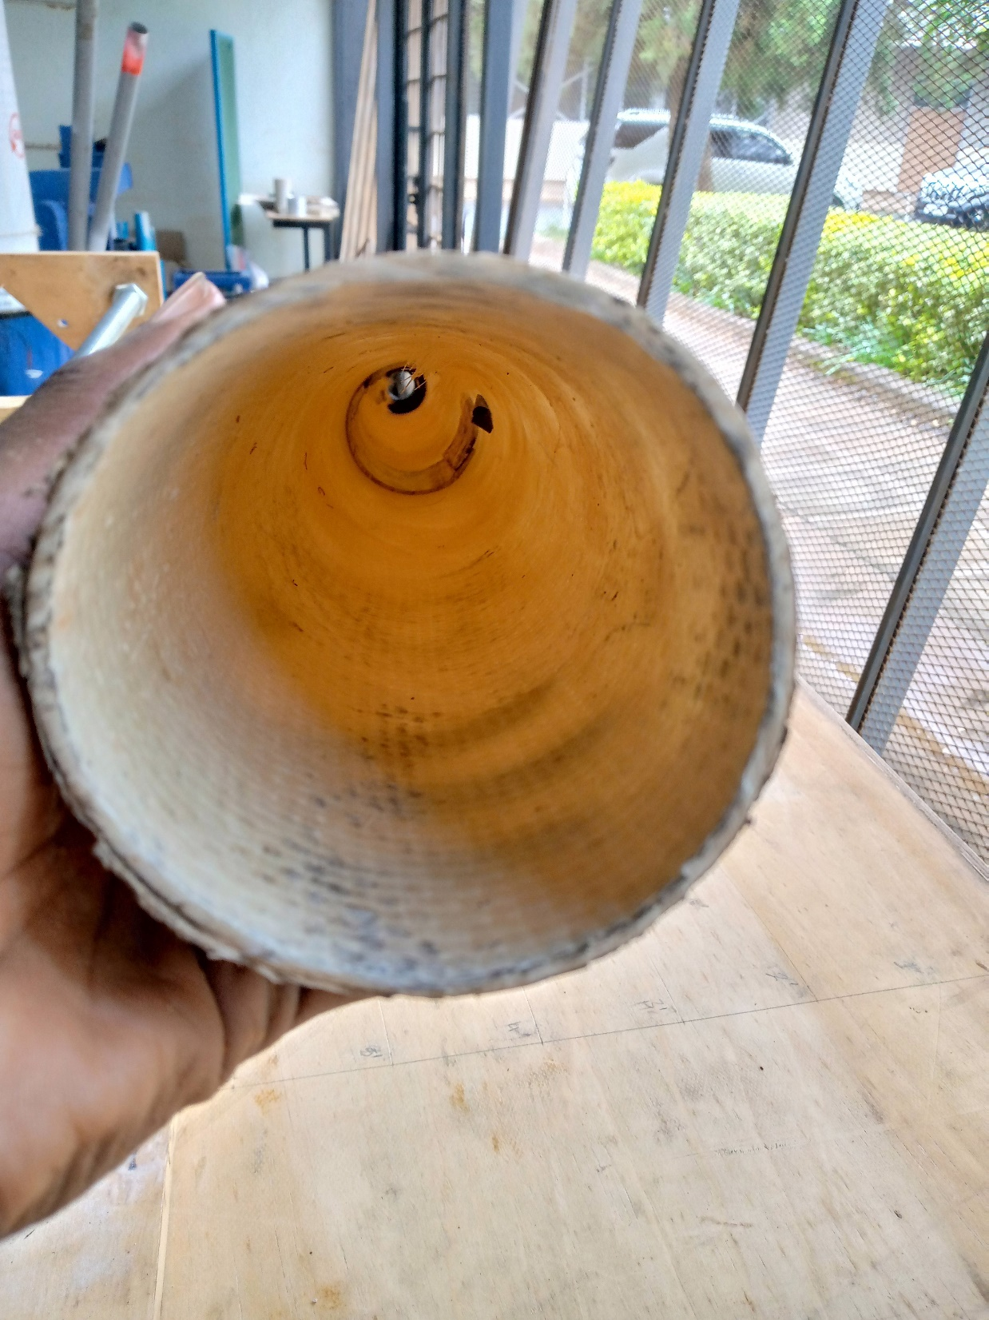
Coupler

Slide 10
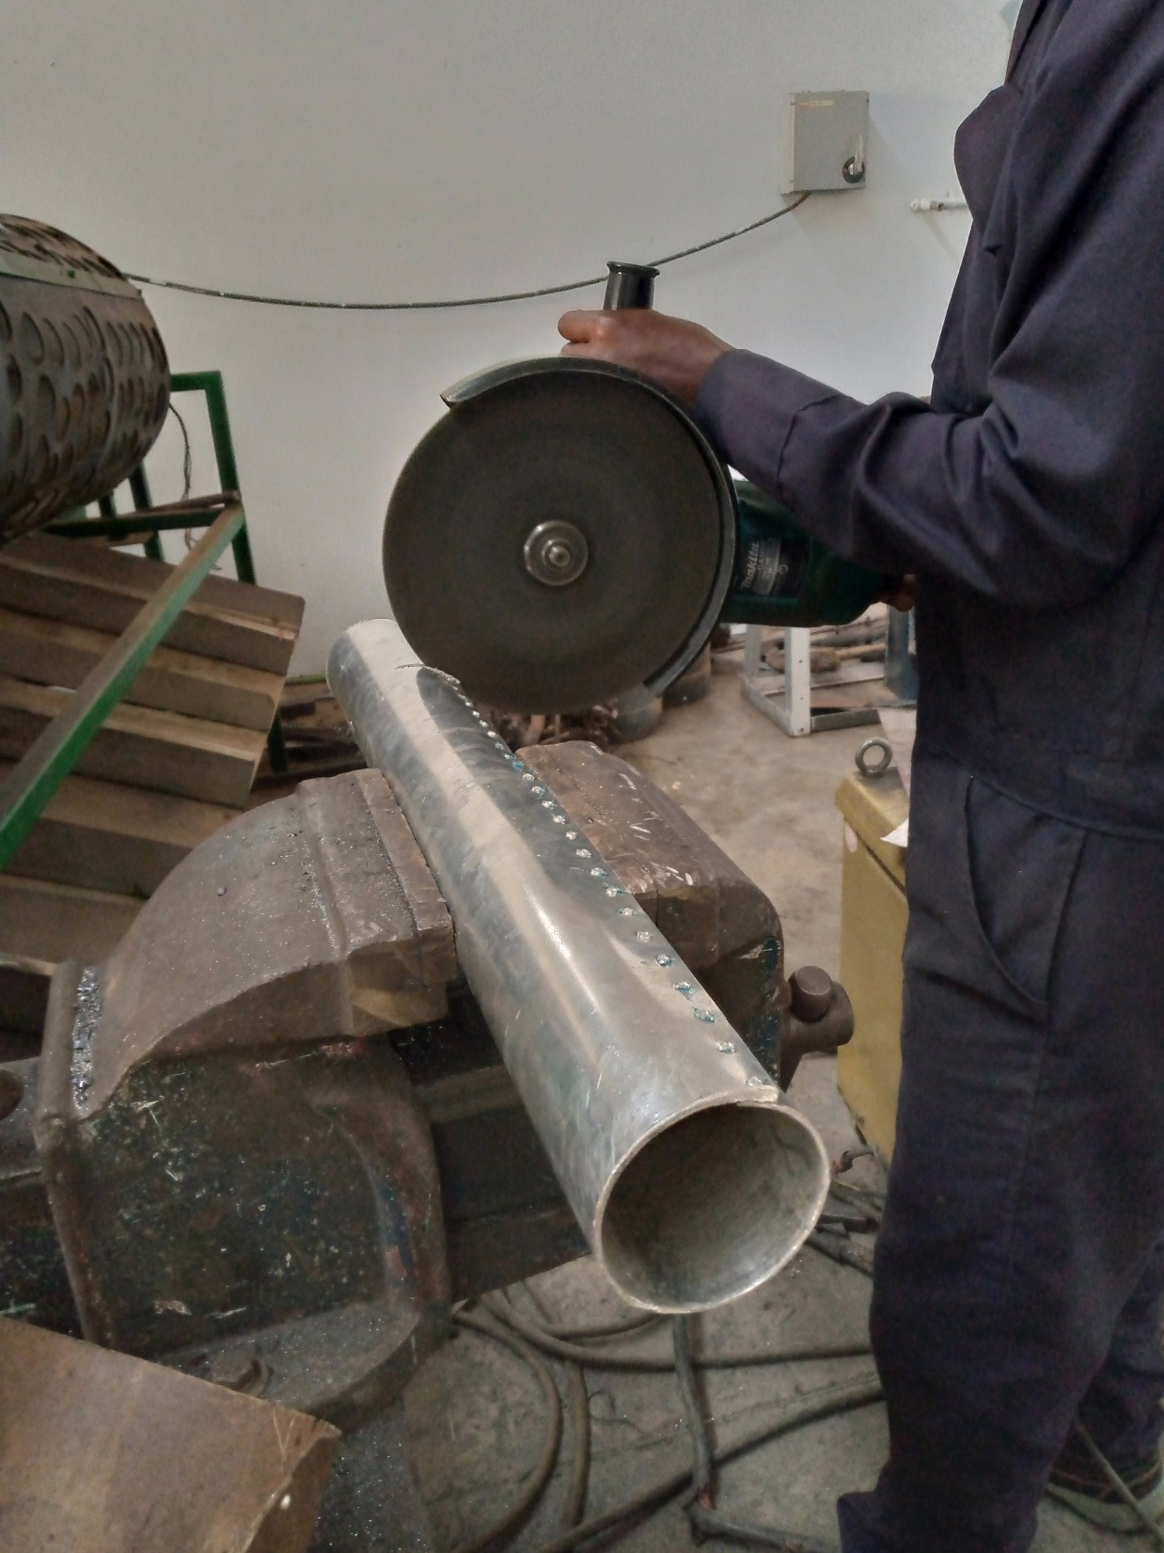
Main body tube to fuselage Coupler
Features;
2 mm thick aluminum
10 cm long
85 mm Outer Diameter

Slide 11
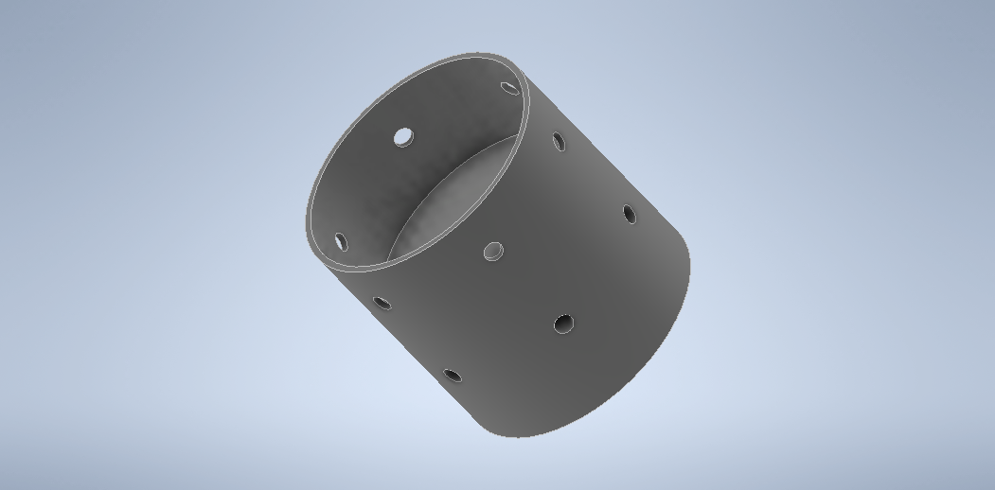
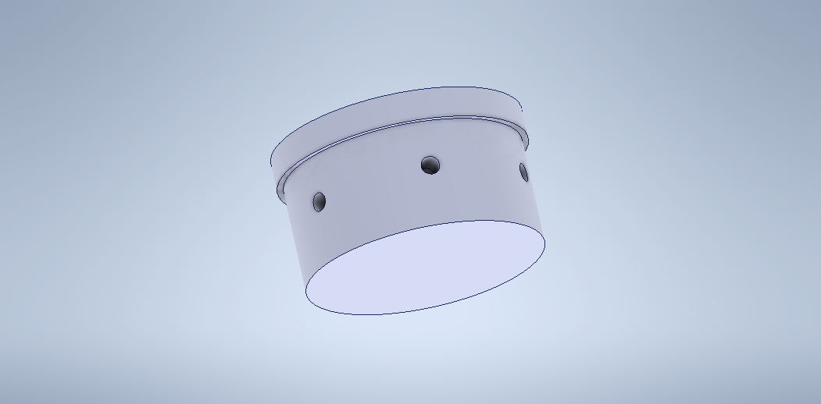
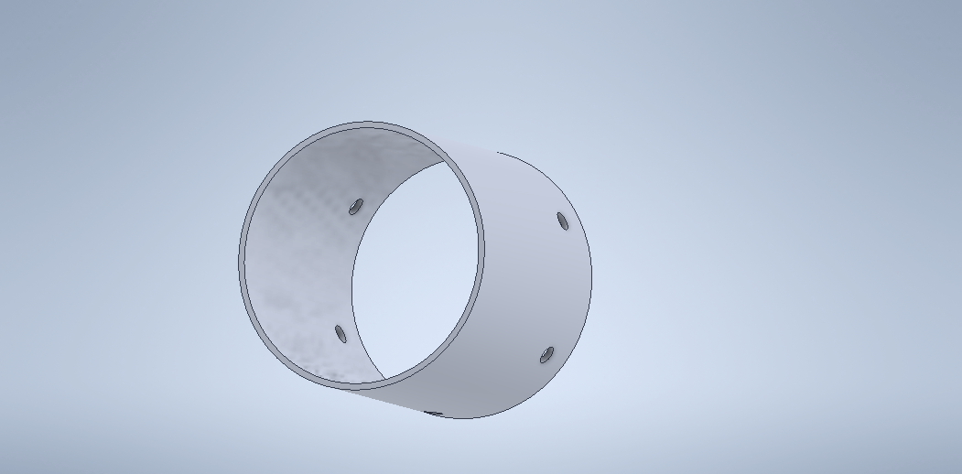
CAD DESIGNS
3D printed (inside) couplers
Aluminum coupler

Slide 12
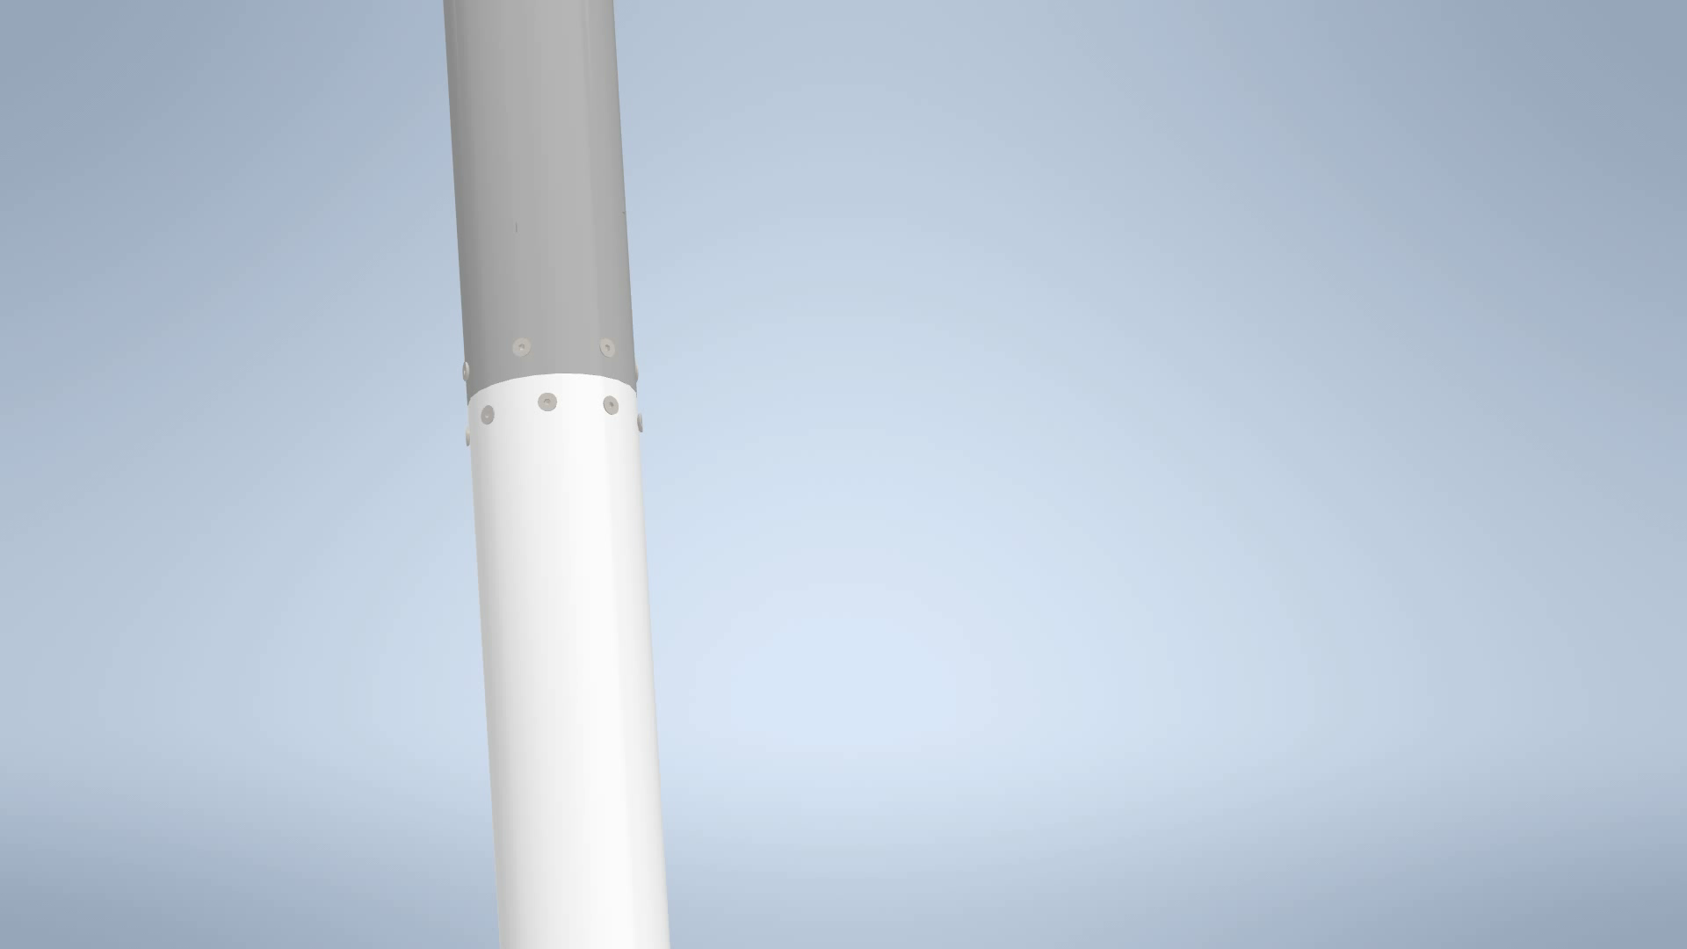
Coupler storyboard

Slide 13
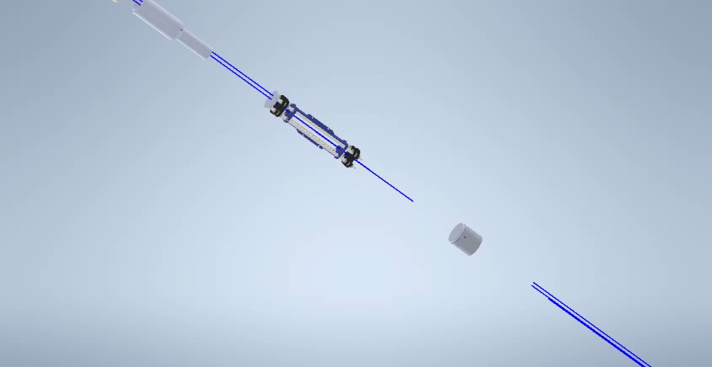

Slide 14
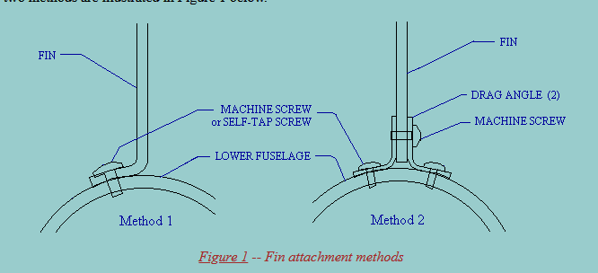
Fin Attachment & Design for Aluminum airframe
Fin: 2mm/1mm thick Aluminum ( To be determined from openRocket)
Alternative is fiberglass or carbon fiber _ Bonding?
Alternative to the screws will be the pop rivets
Adapted from Richard Nakka's Experimental Rocketry Site (nakka-rocketry.net)

Slide 15
NEXT WEEK’S OBJECTIVES
Aluminum fin fabrication and attachment
Fiber glass fin attachment
Fabrication of wind tunnel rocket model
Motor Mount *

Slide 16
Q/A

